Slide 1

Fraction of the Day
Today’s fraction is
$$\frac{1}{2}$$
Complete the worksheet
Notes:
Use the fraction of the day

Slide 2
Setup new INB
Cover page
Contents
Glossary/ formula page
Cornell notes ready to begin

Slide 3
Fraction Terminology revision
(these are the notes from term 1, do not write them down)

Slide 4
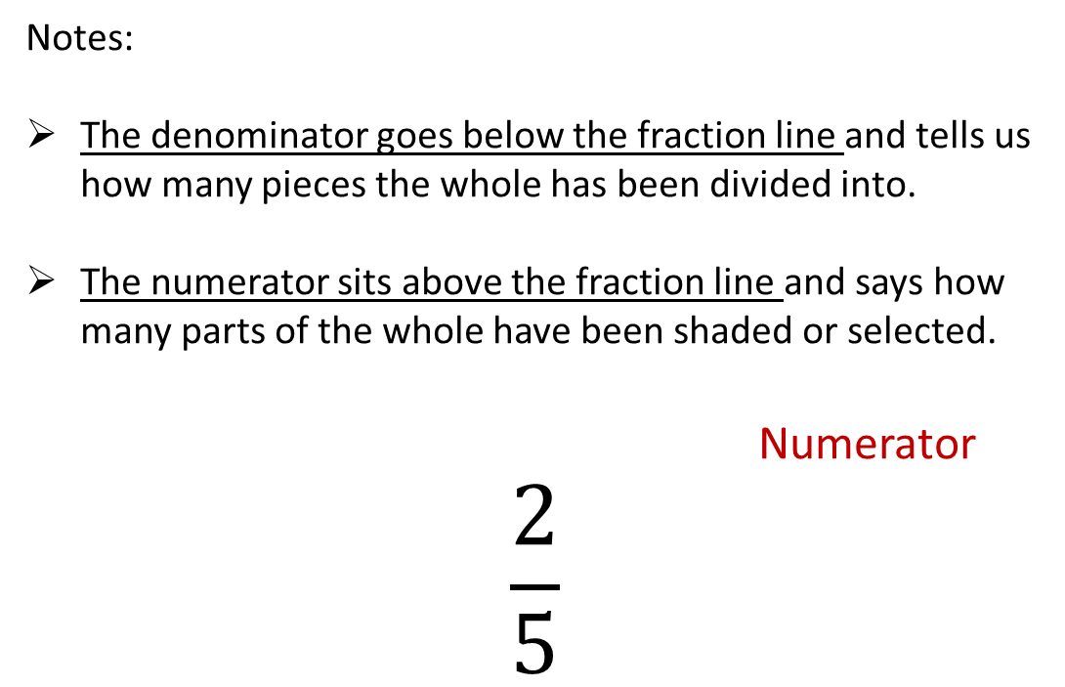
24
7
30
Title: Introduction to fractions
Date:
EQ : Correctly identify and describe the numerator and denominator
Question:
What is the denominator?
What is the numerator?
Notes:
The denominator goes below the fraction line and tells us how many pieces the whole has been divided into.
The numerator sits above the fraction line and says how many parts of the whole have been shaded or selected.
Numerator
$$\frac{2}{5}$$
Denominator
17

Slide 5
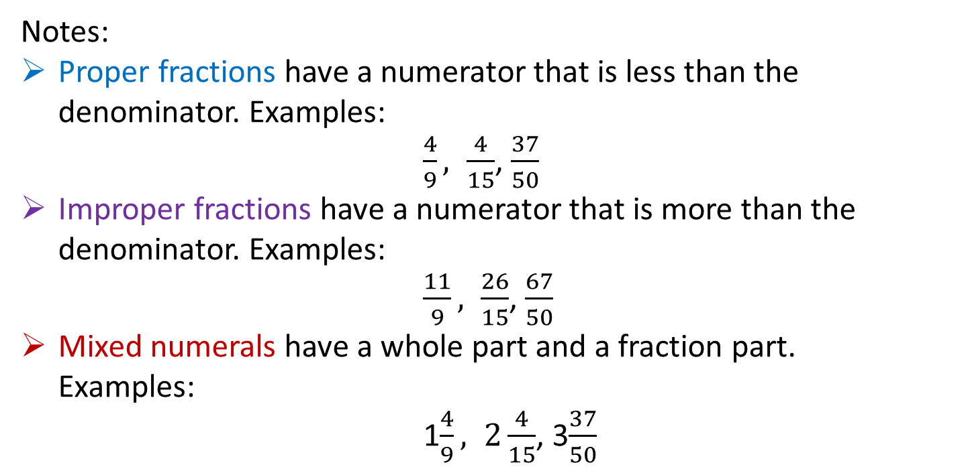
24
7
30
Title: Different types of fractions
Date:
EQ : Identify and describe the three types of fractions proper, improper and mixed numerals.
Question:
Notes:
Proper fractions have a numerator that is less than the denominator. Examples:
$\frac{4}{9}, \frac{4}{15}$, $\frac{37}{50}$
Improper fractions have a numerator that is more than the denominator. Examples:
$\frac{11}{9}, \frac{26}{15}$, $\frac{67}{50}$
Mixed numerals have a whole part and a fraction part.
Examples:
1$\frac{4}{9}, 2\frac{4}{15}$, 3$\frac{37}{50}$
What is a proper fraction?
What is an improper fraction?
What is a mixed numeral?
21

Slide 6
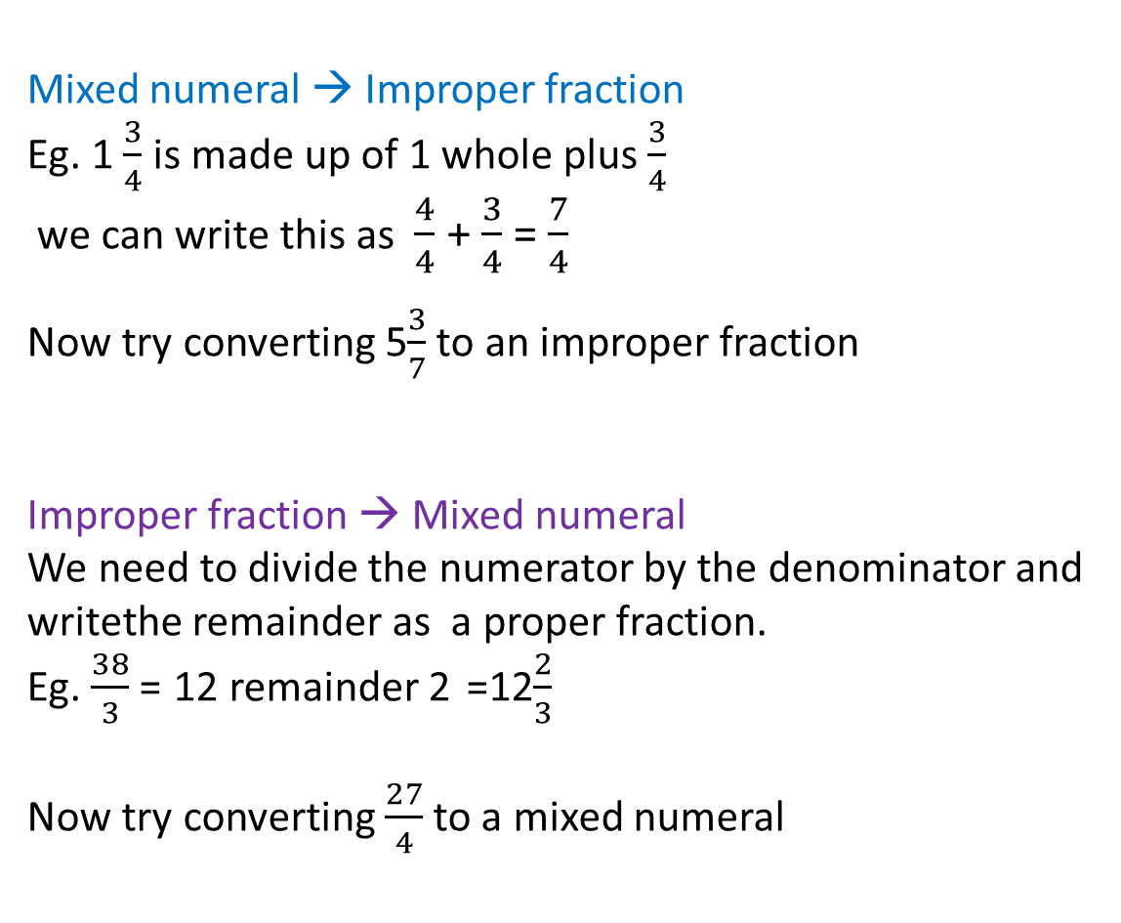
Question:
Notes:
Mixed numeral → Improper fraction
Eg. 1 $\frac{3}{4}$ is made up of 1 whole plus $\frac{3}{4}$
we can write this as $\frac{4}{4}$ + $\frac{3}{4}$ = $\frac{7}{4}$
Now try converting 5$\frac{3}{7}$ to an improper fraction
Improper fraction → Mixed numeral
We need to divide the numerator by the denominator and writethe remainder as a proper fraction.
Eg. $\frac{38}{3}$ = 12 remainder 2 =12$\frac{2}{3}$
Now try converting $\frac{27}{4}$to a mixed numeral
How do we convert a mixed numeral to an improper fraction?
How do we convert an improper fraction to a mixed numeral?

Slide 7
Now we are starting our notes for today

Slide 8
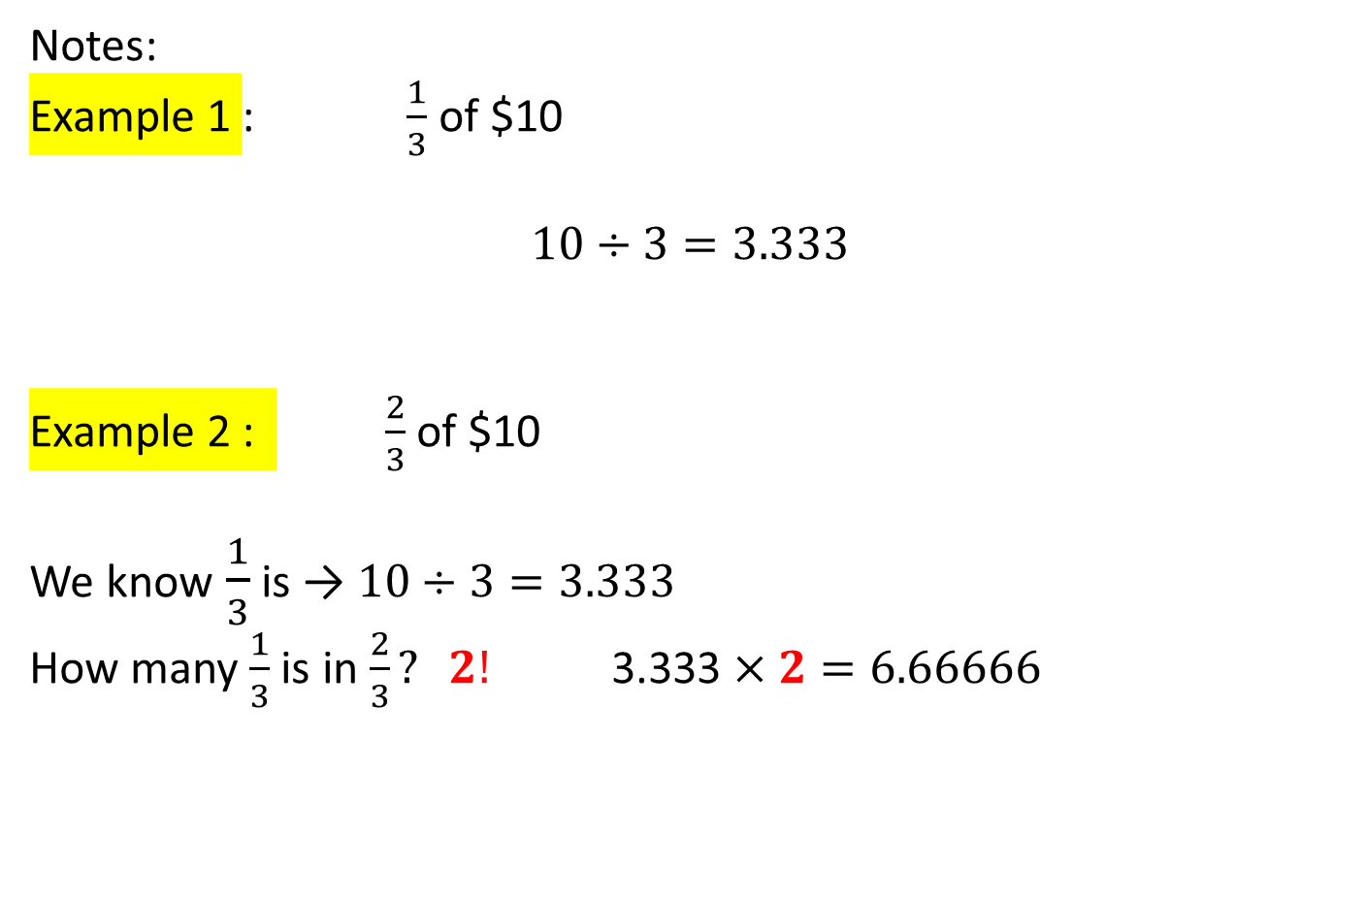
24
7
30
Title: Introduction to Fractions
Date:
EQ : Revise fraction of a quantity and how to simplify fractions
Question:
Notes:
Example 1 : $\frac{1}{3}$ of $10
$$10÷3=3.333$$
Example 2 : $\frac{2}{3}$ of $10
We know$\frac{1}{3}$ is → $10÷3=3.333$
How many $\frac{1}{3}$ is in $\frac{2}{3}? 2!$ 3.333 $×2=6.66666$
How do we find the fraction of a quantity?

Slide 9
Task side Practice
Find 2/5 of 10
Find ¼ of 20
Extra hard! Find 5/8 of 26

Slide 10

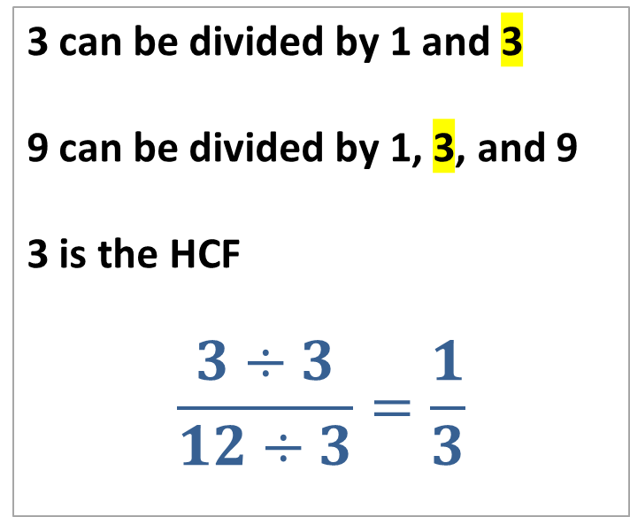
24
7
30
Title: Introduction to Fractions
Date:
EQ : Revise fraction of a quantity and how to simplify fractions
Question:
Notes:
Simplify $\frac{3}{12}$
Step 1 : Find the largest number that can go into BOTH numbers. (This is called the HCF or highest common factor)
Step 2: Divide both numbers by the HCF
Step 3: Re-write the fraction
How do we simplify fractions?
3 can be divided by 1 and 3
9 can be divided by 1, 3, and 9
3 is the HCF
$$\frac{3÷3}{12÷3}=\frac{1}{3}$$

Slide 11
Draw the following Fraction
Complete your Simplifying Fractions handout and glue it into your book!
Notes:
Once they have drawn the fraction, get them to hold up there answer so you can see they have the correct answer. If you have time do more fractions.

